Slide 1


An Open science education crisis (and how to solve it)
Jon Tennant, Open Science MOOC
@OpenSci_MOOC

Slide 2
What is open science?
Open Science is about using science to help address the major challenges to society. (Me)
or...
Open Science is the movement to make scientific research, data and dissemination accessible to all levels of an inquiring society, amateur or professional. (Wikipedia)
or…
Open Science represents a new approach to the scientific process based on cooperative work and new ways of diffusing knowledge by using digital technologies and new collaborative tools. (European Commission)

Slide 3

Open Science principles
Socio-cultural
Technical
Inclusivity
Equality
Accountability
Freedom
Fairness
Rigour
Transparency
Reproducibility
FAIR principles
TOP guidelines

Slide 4


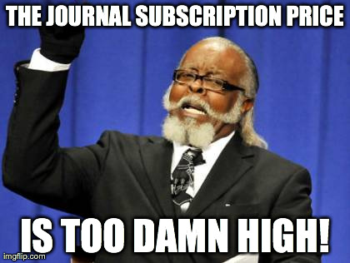
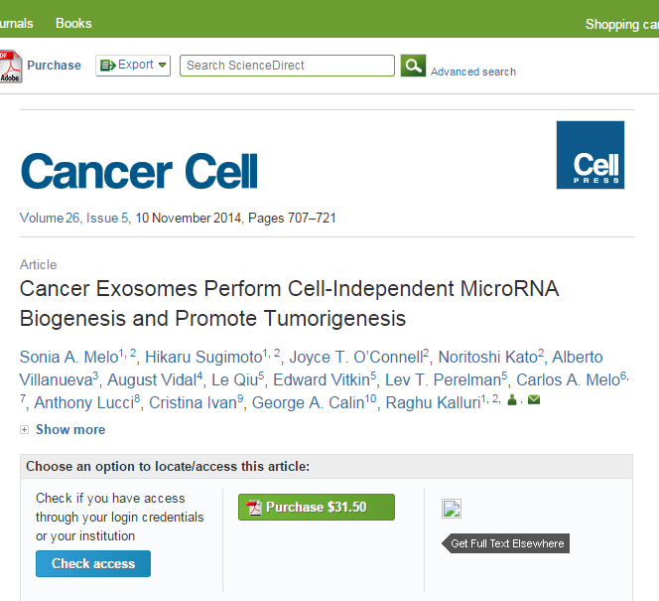
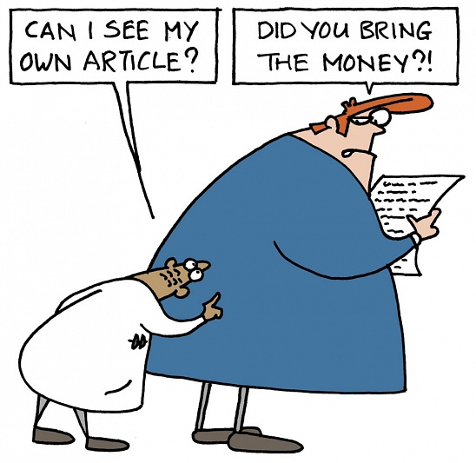

HOW IS THIS HELPING SCIENCE HAVE AN IMPACT ON THE GLOBAL CHALLENGES WE FACE?
BARRIERS

Slide 5
Barriers to open science
FEAR
POWER
COMPETITION
Socio-cultural
Technological
Political
Organisational
Economic
Legal
Educational
INERTIA

Slide 6
The big one
Your career
Open Science
SOCIAL AND TECHNICAL BARRIERS

Slide 7
Values in open science
Drivers
Barriers
Reduce publication bias
Increase replicability
Increase reliability of scientific record
Make publicly funded research publicly accessible
Make research more efficient
Fear of scooping or ideas being stolen
Fear of not being credited for ideas
Fear of errors and public humiliation
Fear of risk to reputation
Fear of reduced scientific quality
Fear of information overload

Slide 8
Social and environmental factors
Drivers
Barriers
Dissatisfaction with traditional models
Interest in experimentation
Objection to assessment criteria
Demand for public accountability
Desire to influence global challenges
Career benefits through visibility
Digital-savvy emergent workforce
Lack of awareness and training
Cultural inertia and misinformation
Challenging the establishment
Follow the status quo to succeed
Perceived lack of reward
Perceived subversion of science
Short-sighted funding decisions

Slide 9
Combating Fear, misinformation,and inertia with an injection of cold, hard, education
Did someone say Open Science MOOC?

Slide 10
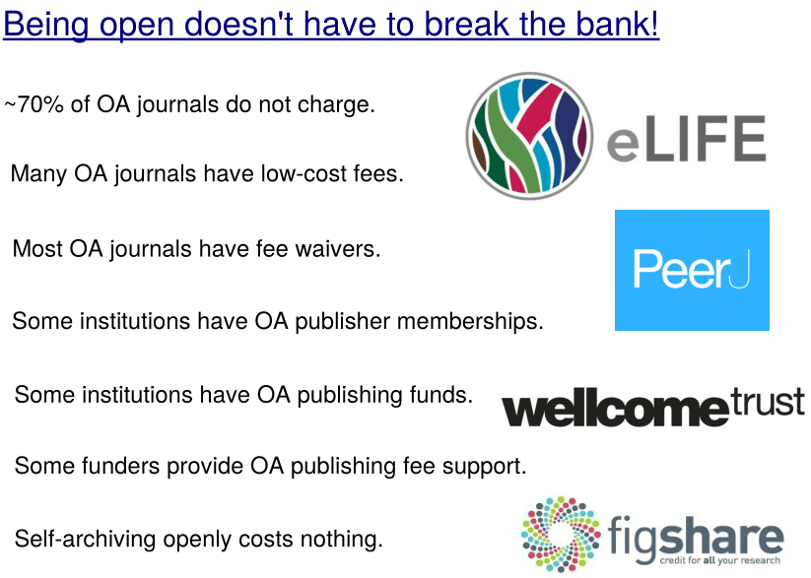
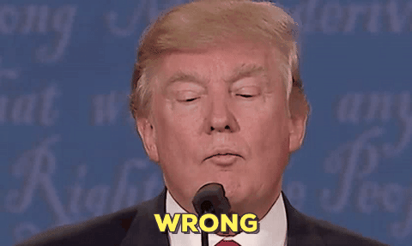
“Open Access is too expensive.”

Slide 11
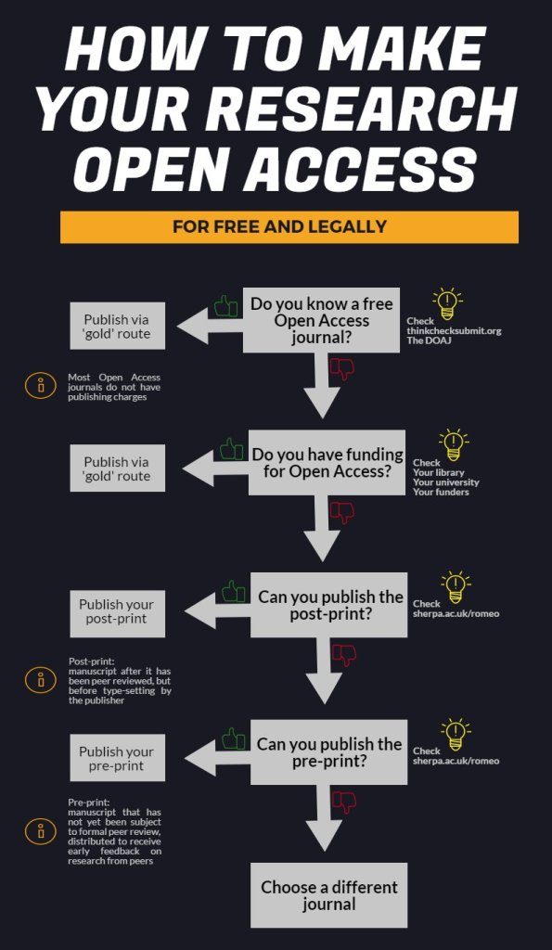
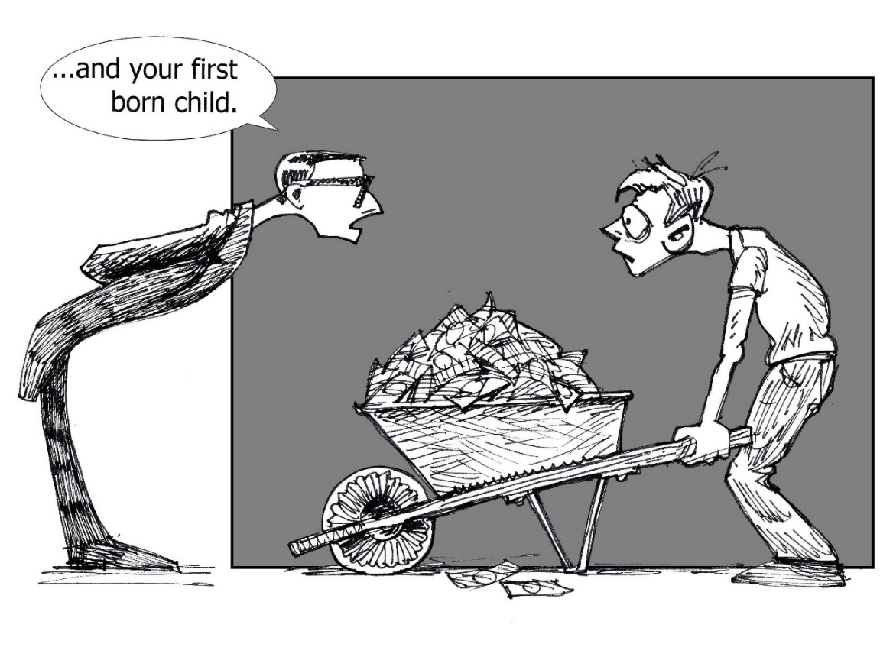

Almost all journals allow some form of it
Easily discoverable via e.g., Unpaywall, Kopernio
Also, Google Scholar…
Common view about high costs is due to a combination of monopolisation and political broadsiding and sabotage by commercial publishers.
https://figshare.com/collections/How_to_make_your_work_100_Open_Access_for_free_and_legally_multi-lingual_/3943972

Slide 12
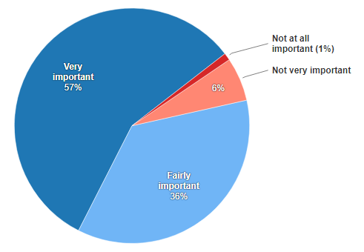
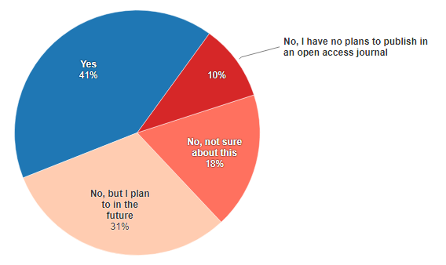
In my country there is problem...
“Researchers under 35 as well as PhD candidates, master’s students and research assistants had the least experience with open-access publishing.”
https://www.natureindex.com/news-blog/young-researchers-preach-open-access-yet-many-dont-practice

Slide 13
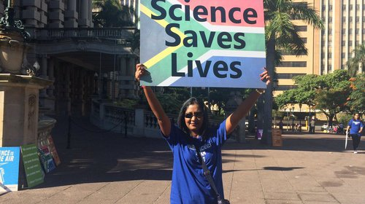
Attitudes vs practice
“60.8% of researchers do not self-archive their work even when it is free and in keeping with journal policy.”
- Smith et al., (2017)
“In a field where OA seems of practical and ethical importance for the sharing of knowledge promoting health equity, it is surprising that researchers do not make their papers available when they are legally able to do so without any cost.”
- Smith et al., (2017)
https://health-policy-systems.biomedcentral.com/articles/10.1186/s12961-017-0235-3

Slide 14
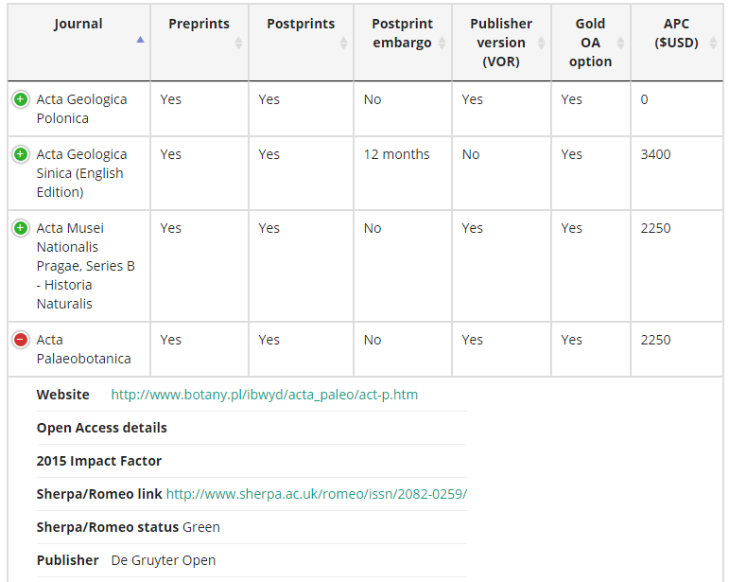
An OA education crisis
There is ALWAYS an Open Access option.
You just have to do some of that thing... What’s it called again..?
RESEARCH.
https://paleorxiv.github.io/journal_policies.html

Slide 15
No choice in publishing venue
Forced to play the game
Reinforcement of power imbalances
Cultural inertia and innovation stifling
Commercial interests govern
The consequence?
Sound familiar?

Slide 16
What it all comes down to
Guidance
Lack of clarity over assessment of outputs and activities. Lack of adequate training and education.
Incentives
Lack of professional incentives for Open Science. Innovators are marginalised.
Rewards
Hiring, promotion, tenure decisions all fail to account for Open Science activities.

Slide 17
It is time to change the conversation
Open Science is f-ing awesome

Slide 18
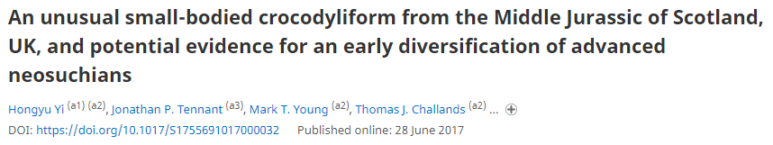
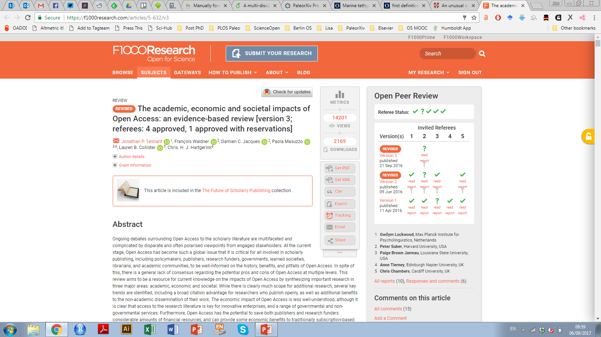
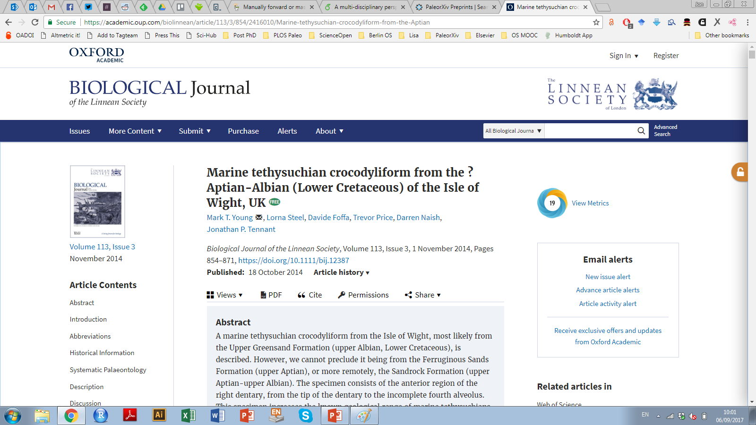
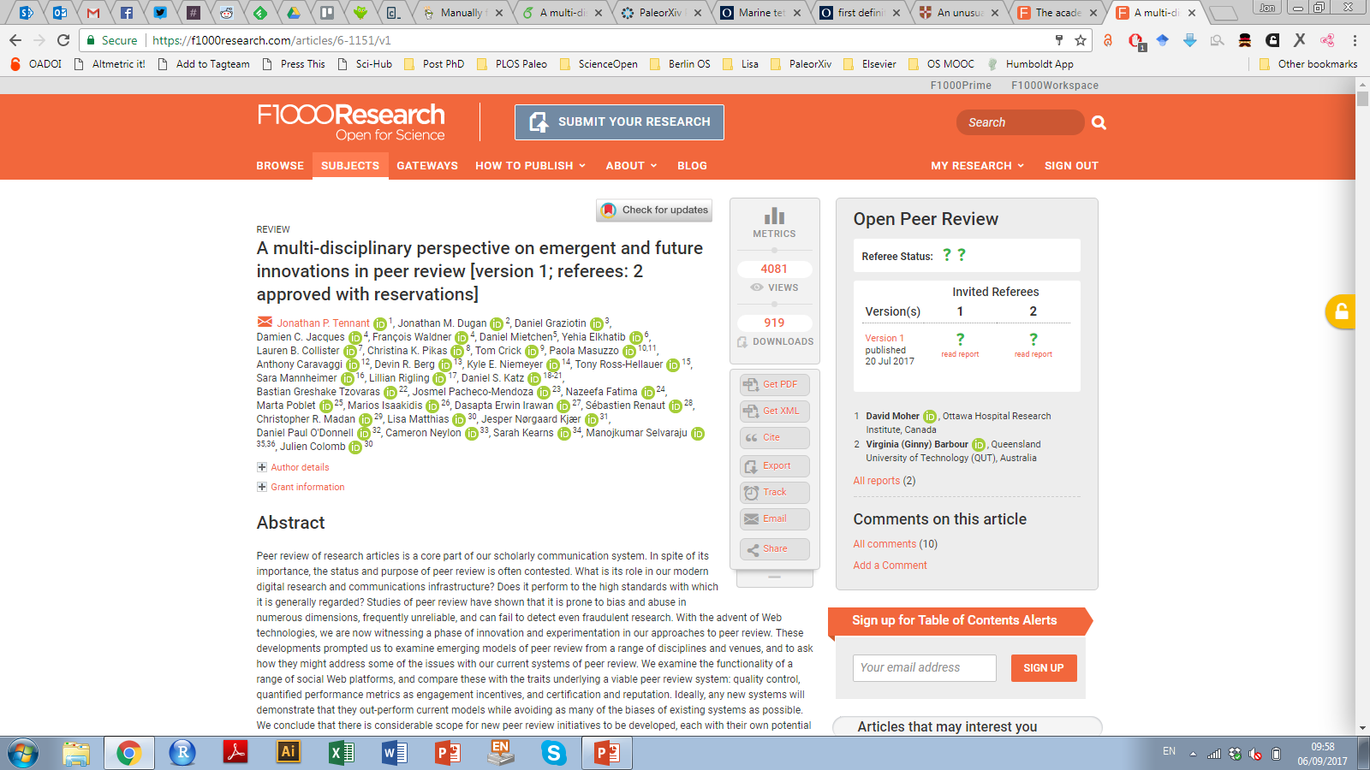
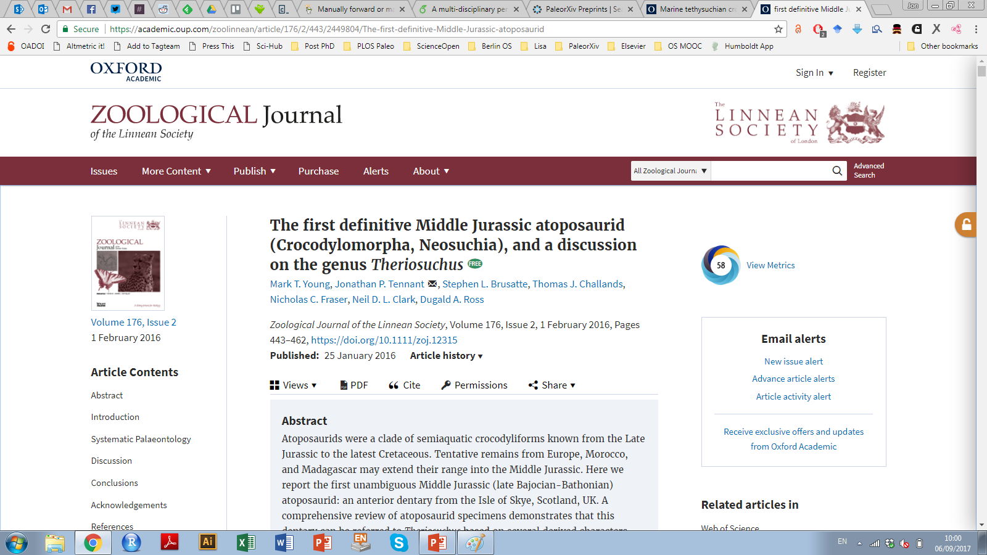
Being unconventional can help you succeed

Slide 19
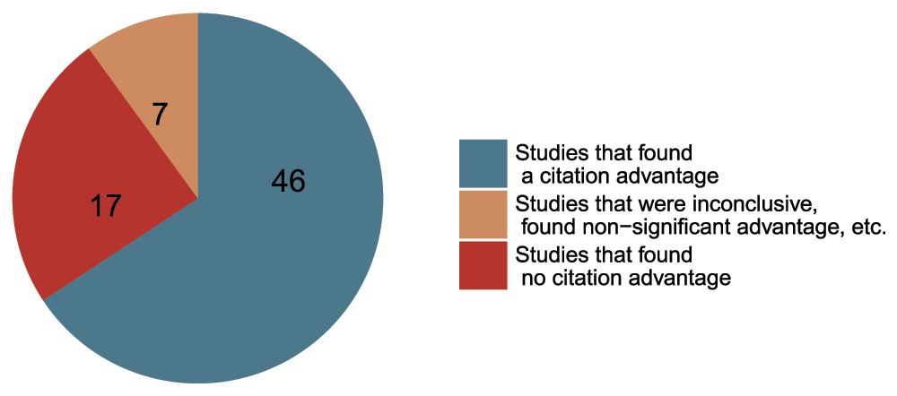
Open Access boosts your citations
Data from The Open Access Citation Advantage Service, SPARC Europe, accessed March 2016.
http://f1000research.com/articles/5-632/v3

Slide 20
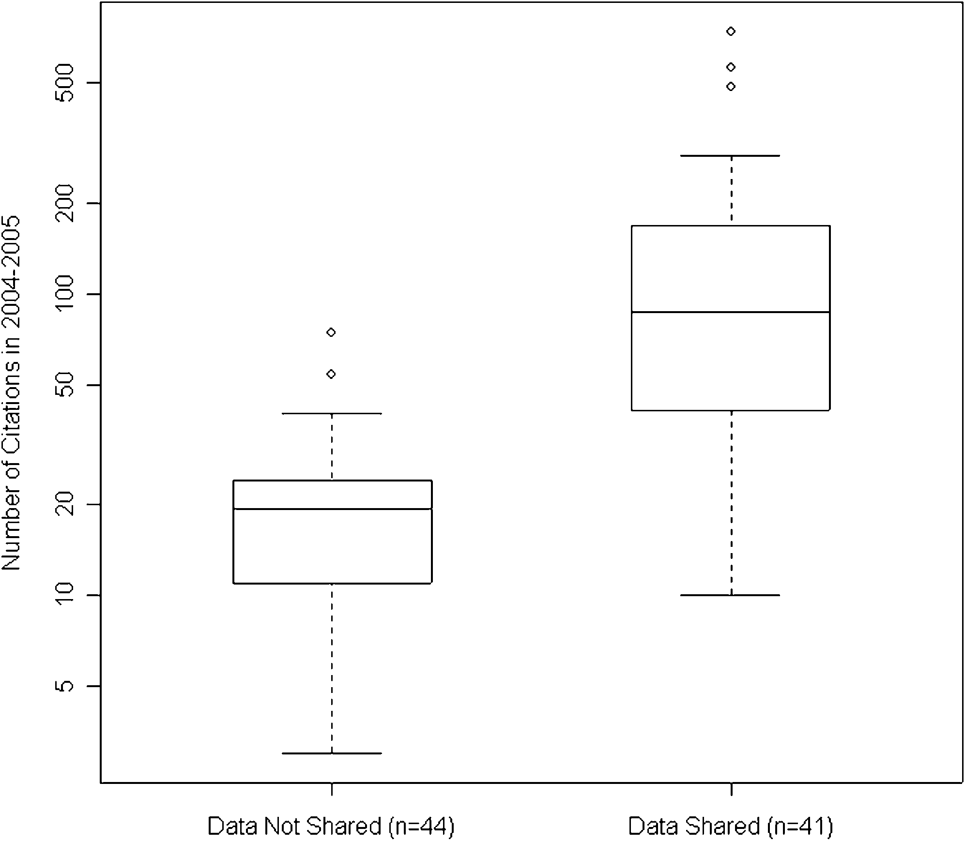
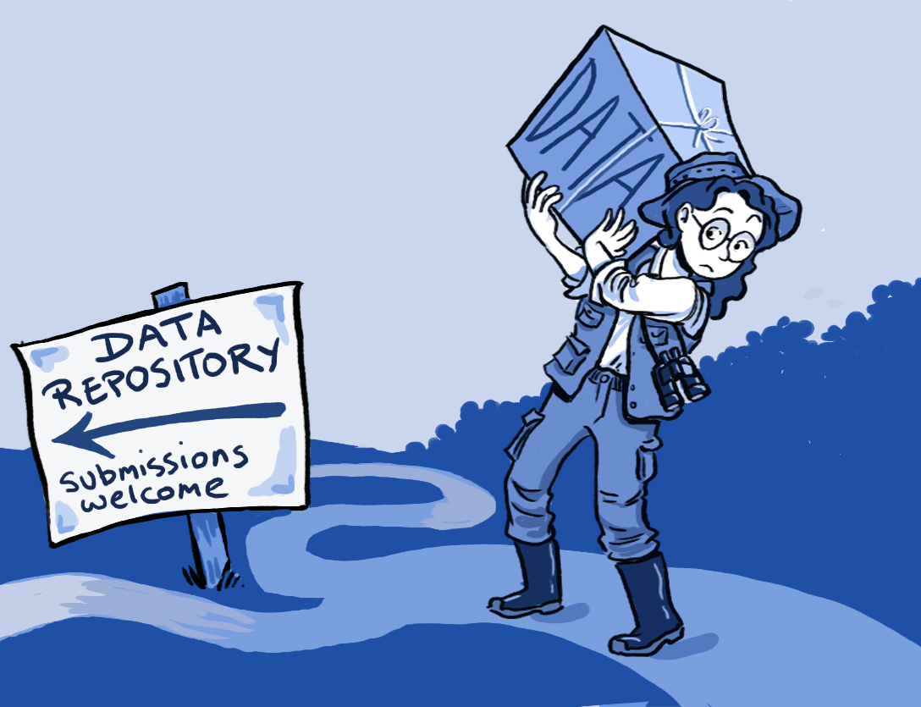
Open DATA boosts your citations
https://scholarlykitchen.sspnet.org/2014/12/09/whats-going-on-in-the-library-part-2-the-convergence-of-data-repositories-and-library-publishers/
http://whyopenresearch.org/
https://peerj.com/articles/175/

Slide 21
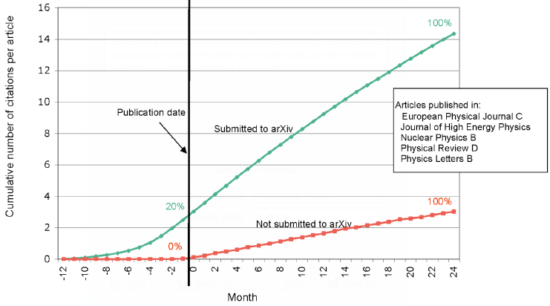
Preprints boost your citations
Rapid communication
Greater exposure
More citations, faster and earlier
http://whyopenresearch.org/

Slide 22
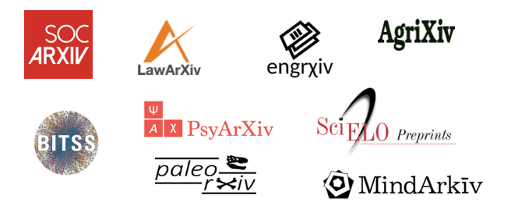





It’s your work. Publish where you want. But don’t lock it up.

Slide 23
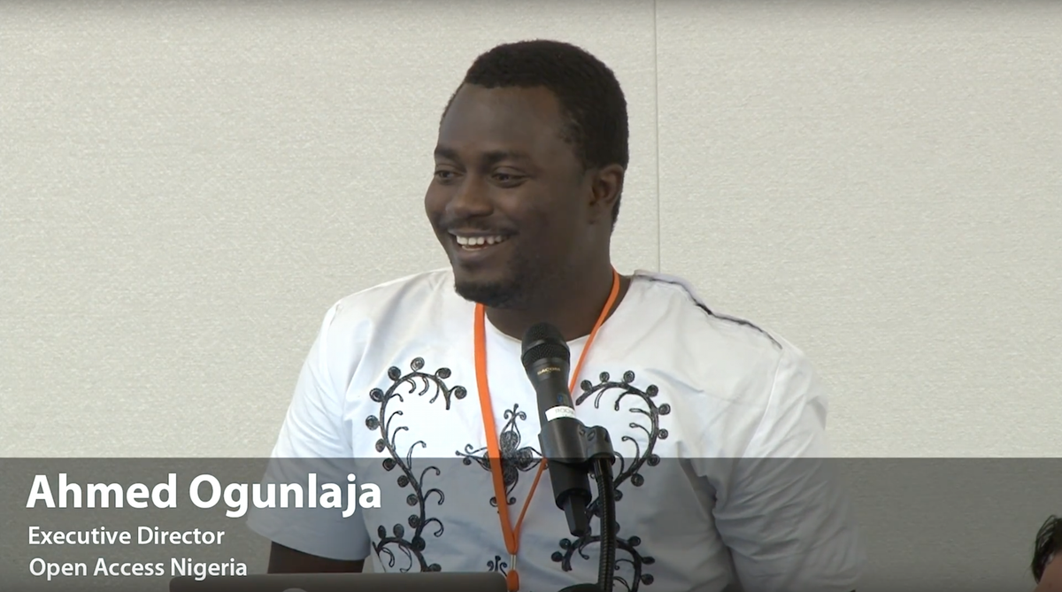
“Open Access wins all of the arguments, all of the time.”
- OpenCon 2014

Slide 24
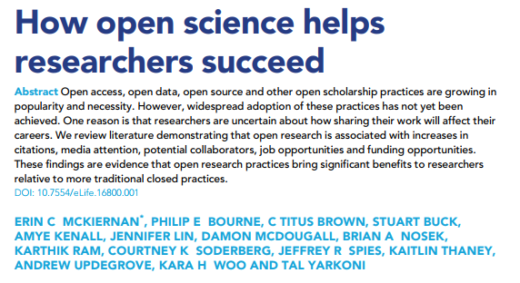
Homework
https://elifesciences.org/articles/16800

Slide 25
Your career
Open Science
SOCIAL AND TECHNICAL BARRIERS

Slide 26
Your career
Open Science
TECHNICAL BARRIERS
SOCIAL BARRIERS
EDUCATION

Slide 27
What do we need to change the culture?
Education and training for our students
Learn skills for new ways of doing research
Empowerment and leadership for the next generation
Build a global community based on sharing and collaboration
Massive-scale engagement to re-align Open Science with current incentive structures

Slide 28

Enter the mooc-ateers
I didn‘t come up with that name..

Slide 29

How did this idea come about?
https://opensciencemooc.eu/

Slide 30
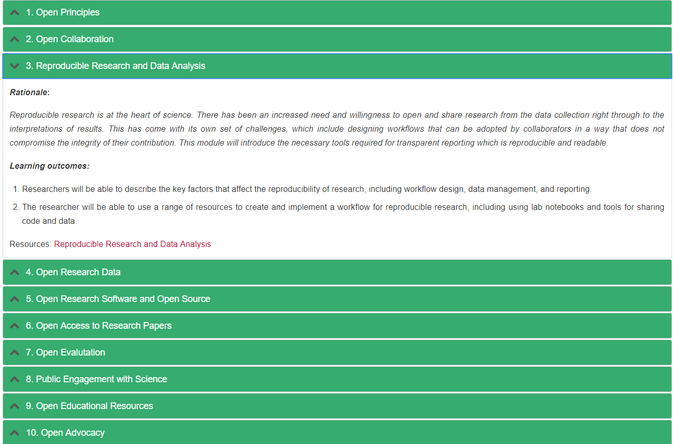
Ten core modules
Rationale
Learning
outcomes
Key resources

Slide 31

Where are we at now?
150+ volunteers signed up to contribute!
14 strong international Steering Committee of awesome people
Code of Conduct, Diversity Statement, Terms of Service
Everything on Etherpad or Google Drive

Slide 32
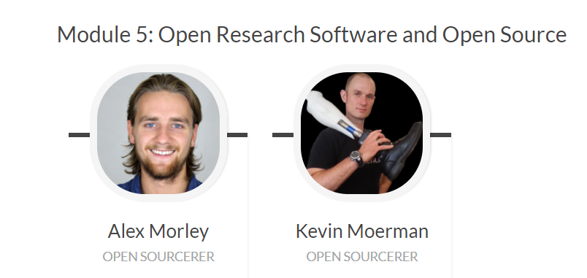
Pilot module production
https://github.com/OpenScienceMOOC/Module-5-Open-Research-Software-and-Open-Source

Slide 33
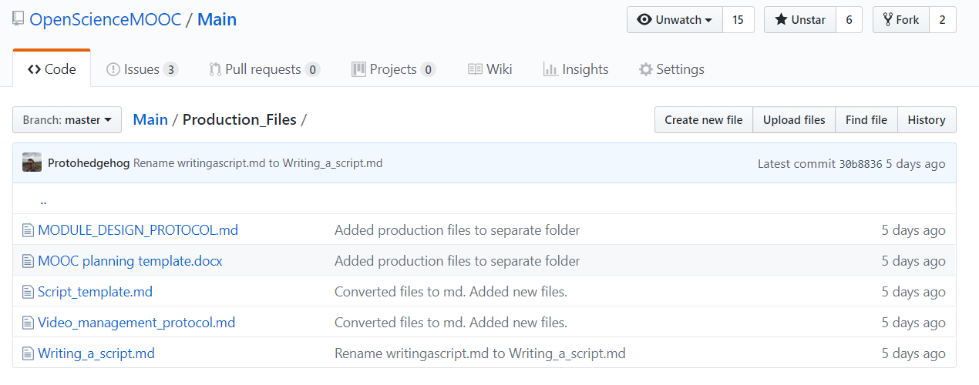
Github all the things
https://github.com/mozilla/global-sprint/issues/253

Slide 34



Partners
https://opensciencemooc.eu/about-us/partners/

Slide 35
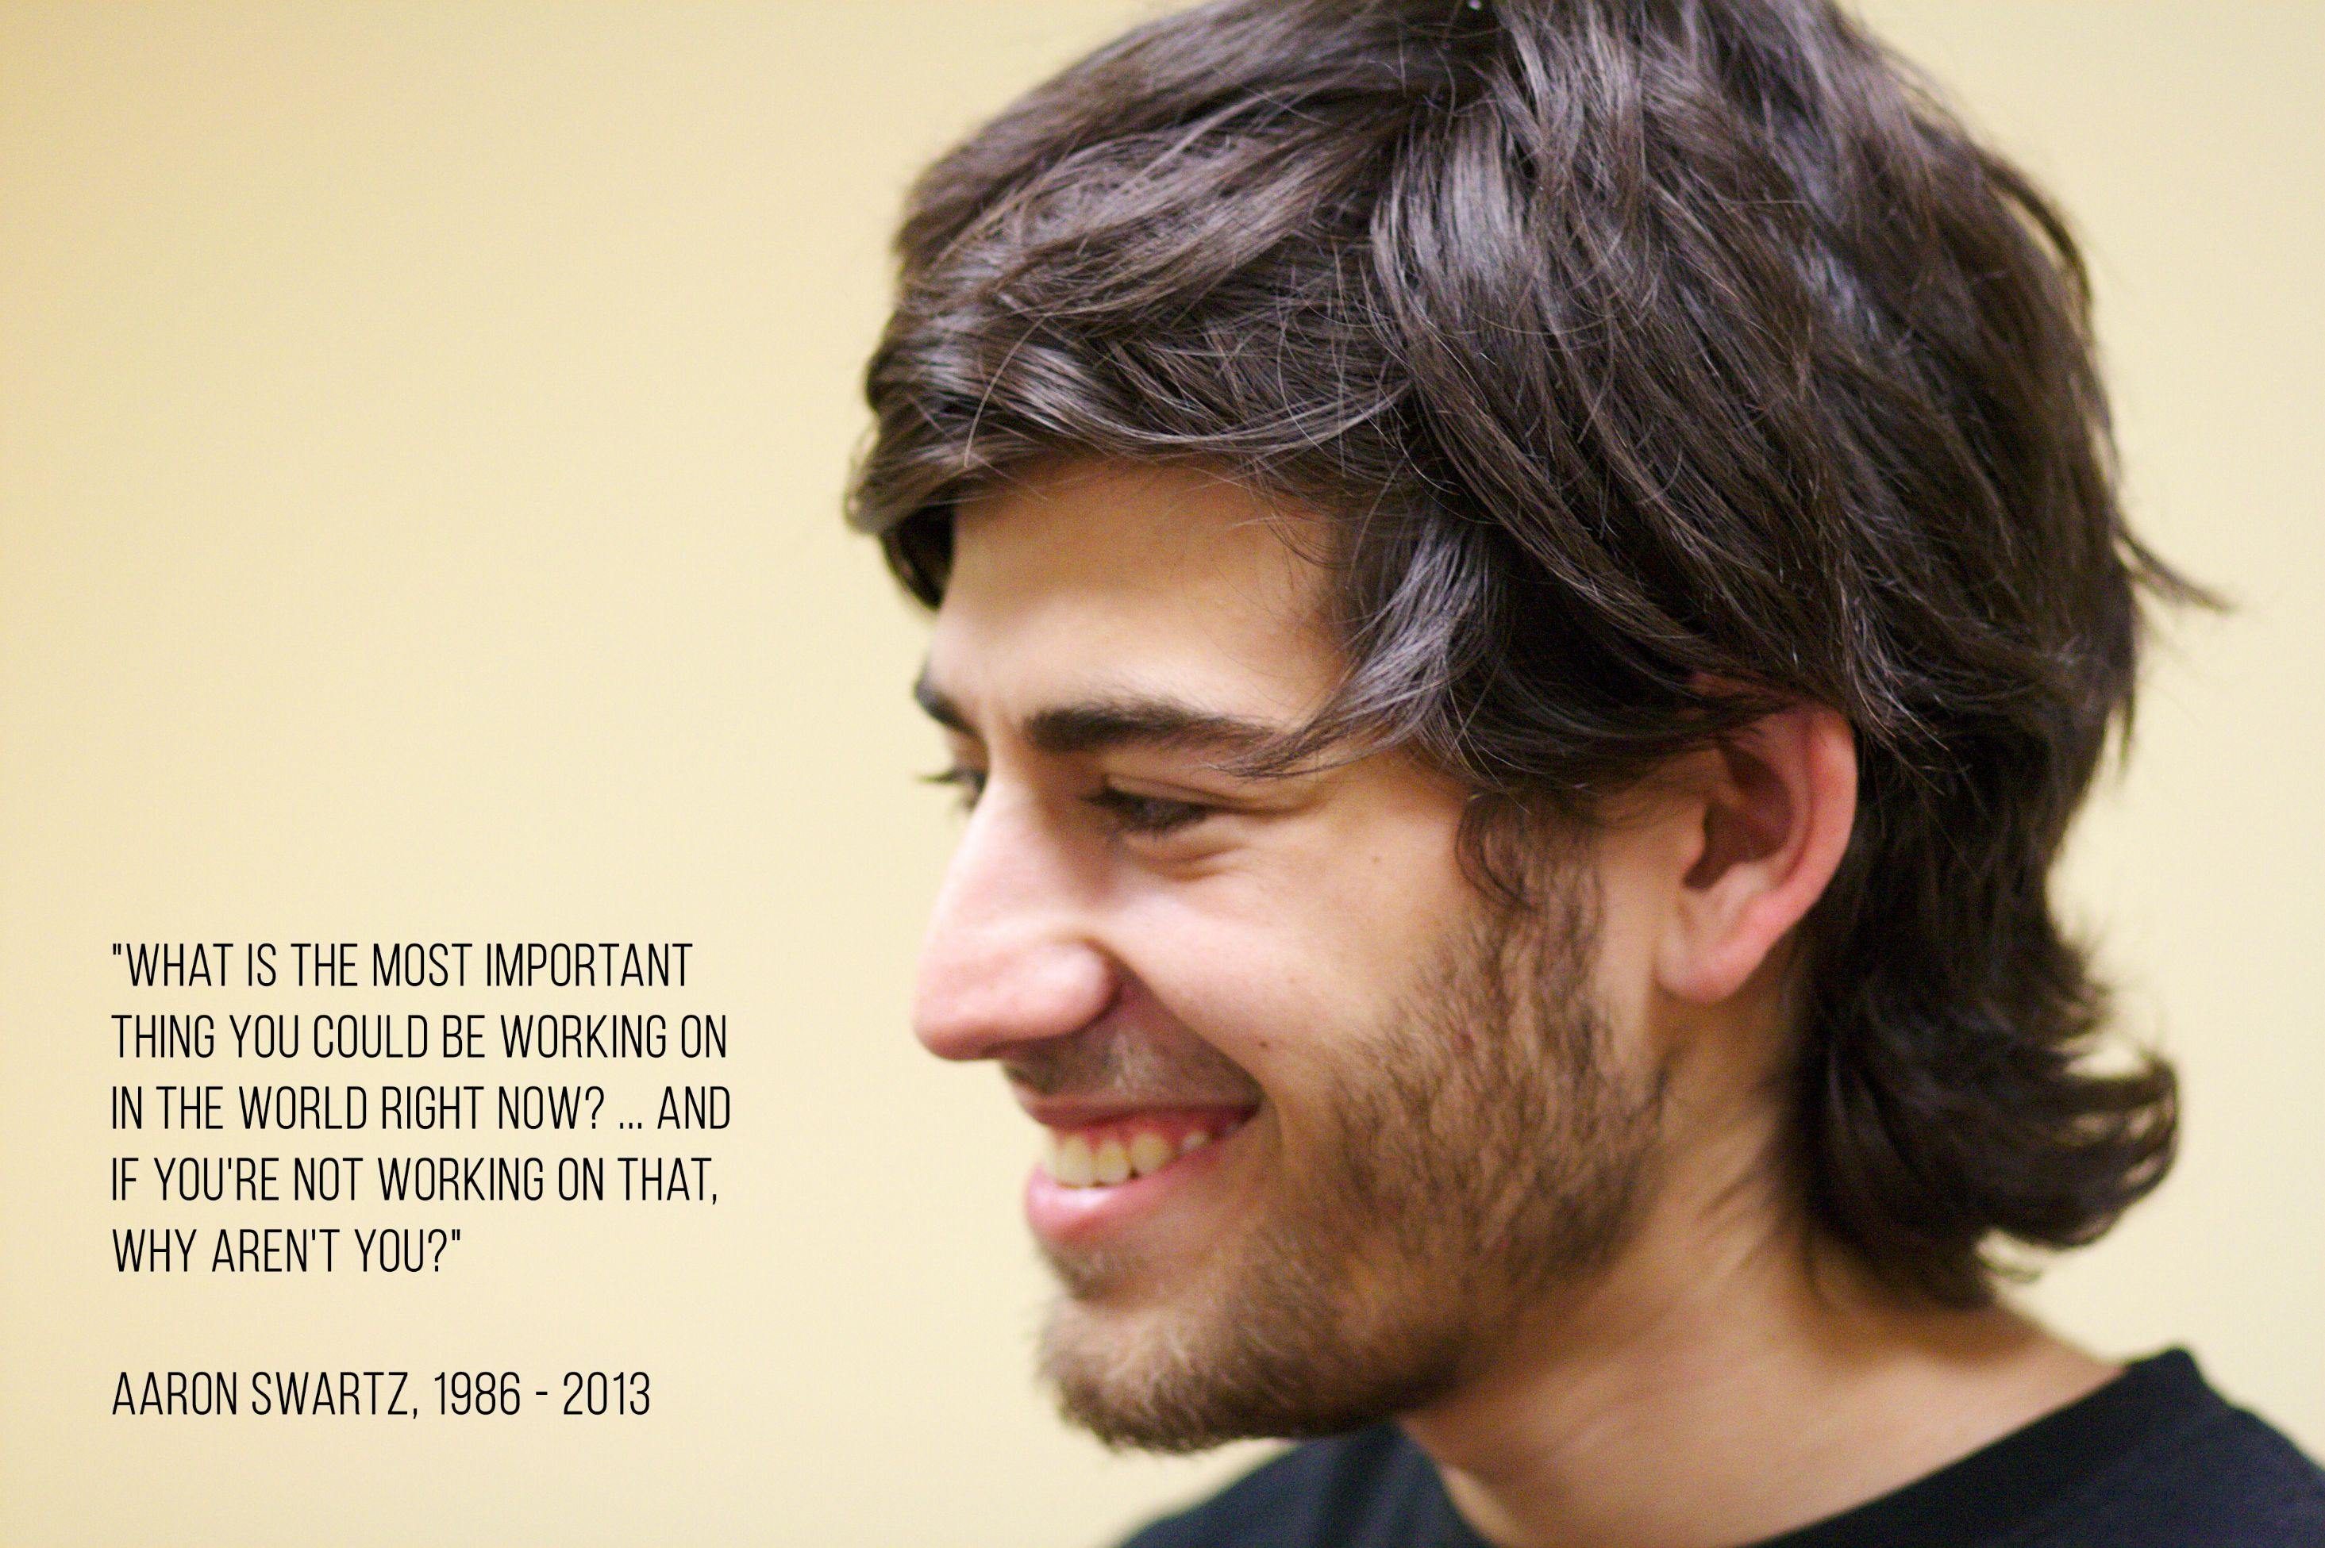
Next steps
Development of pilot module
Core team initiation
Open development
Campaign for strategic partnerships
Raise institutional support
Migrate site to Git Pages
Solve the Open Science education crisis

